Slide 1
Code of Conduct
Incident Response Training
Please change your Zoom name
to include your pronouns
(if you're comfortable sharing them)
It's under Participants, hover over your name,
click rename
CC NC-BY-SA
Otter Tech LLC
sharp@otter.technology

Slide 2
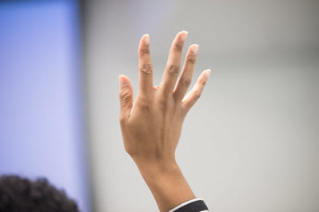
Workshop Format
Slide presentations
Please ask questions!
Use "raise hand" in Zoom
Paired practice
You'll need audio
Scenarios sent via email
Group discussion
5 min break at 1:30 in, 15 min break at 2:30 in
Public domain:
U.S. Department of Agriculture

Slide 3
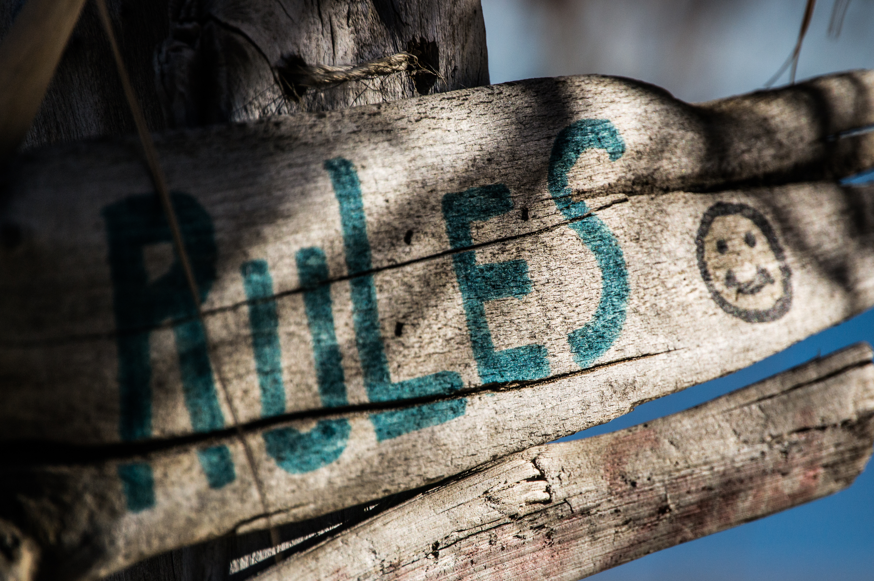
Ground Rules
This is a safe(r) space
If you are asked to stop, you will stop
You may leave at any time
Be open to new knowledge
Acknowledge different lived experiences
CC BY Steve Johnson

Slide 4
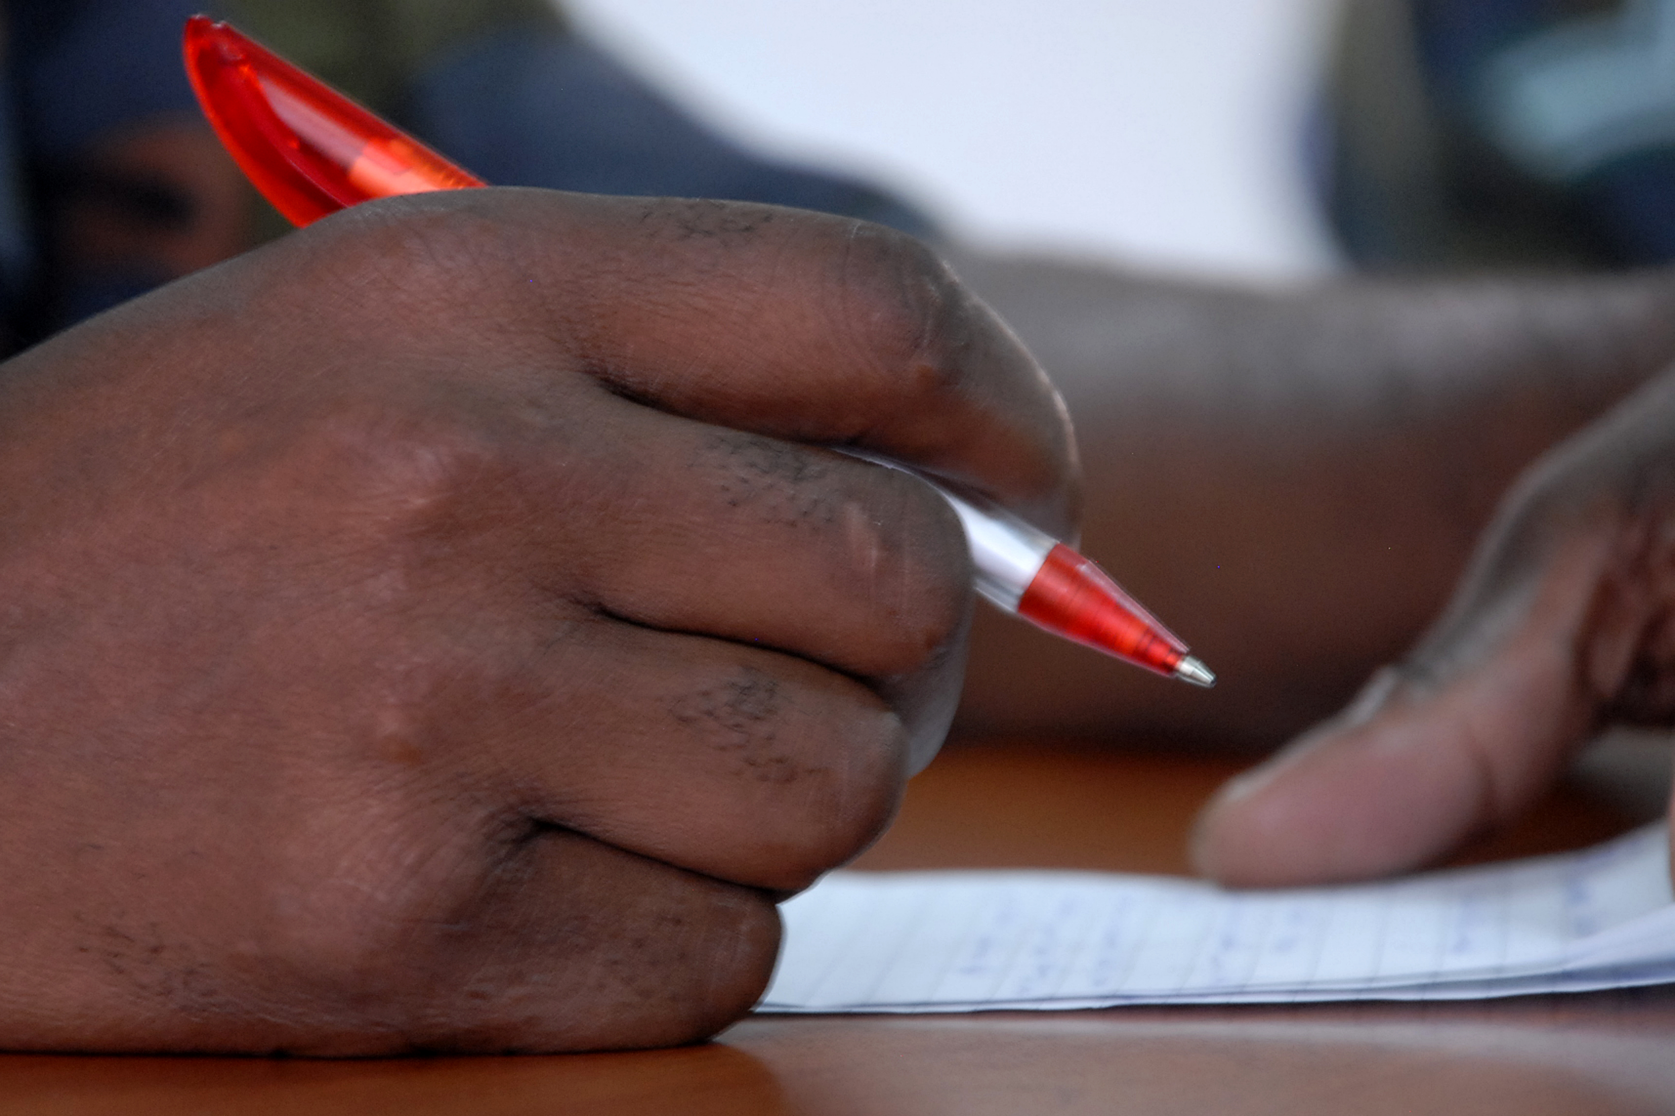
Vocabulary
Code of Conduct incident
Reporter
Reported person
Third party witness
Incident Responder
CC BY U.S. Army Africa

Slide 5
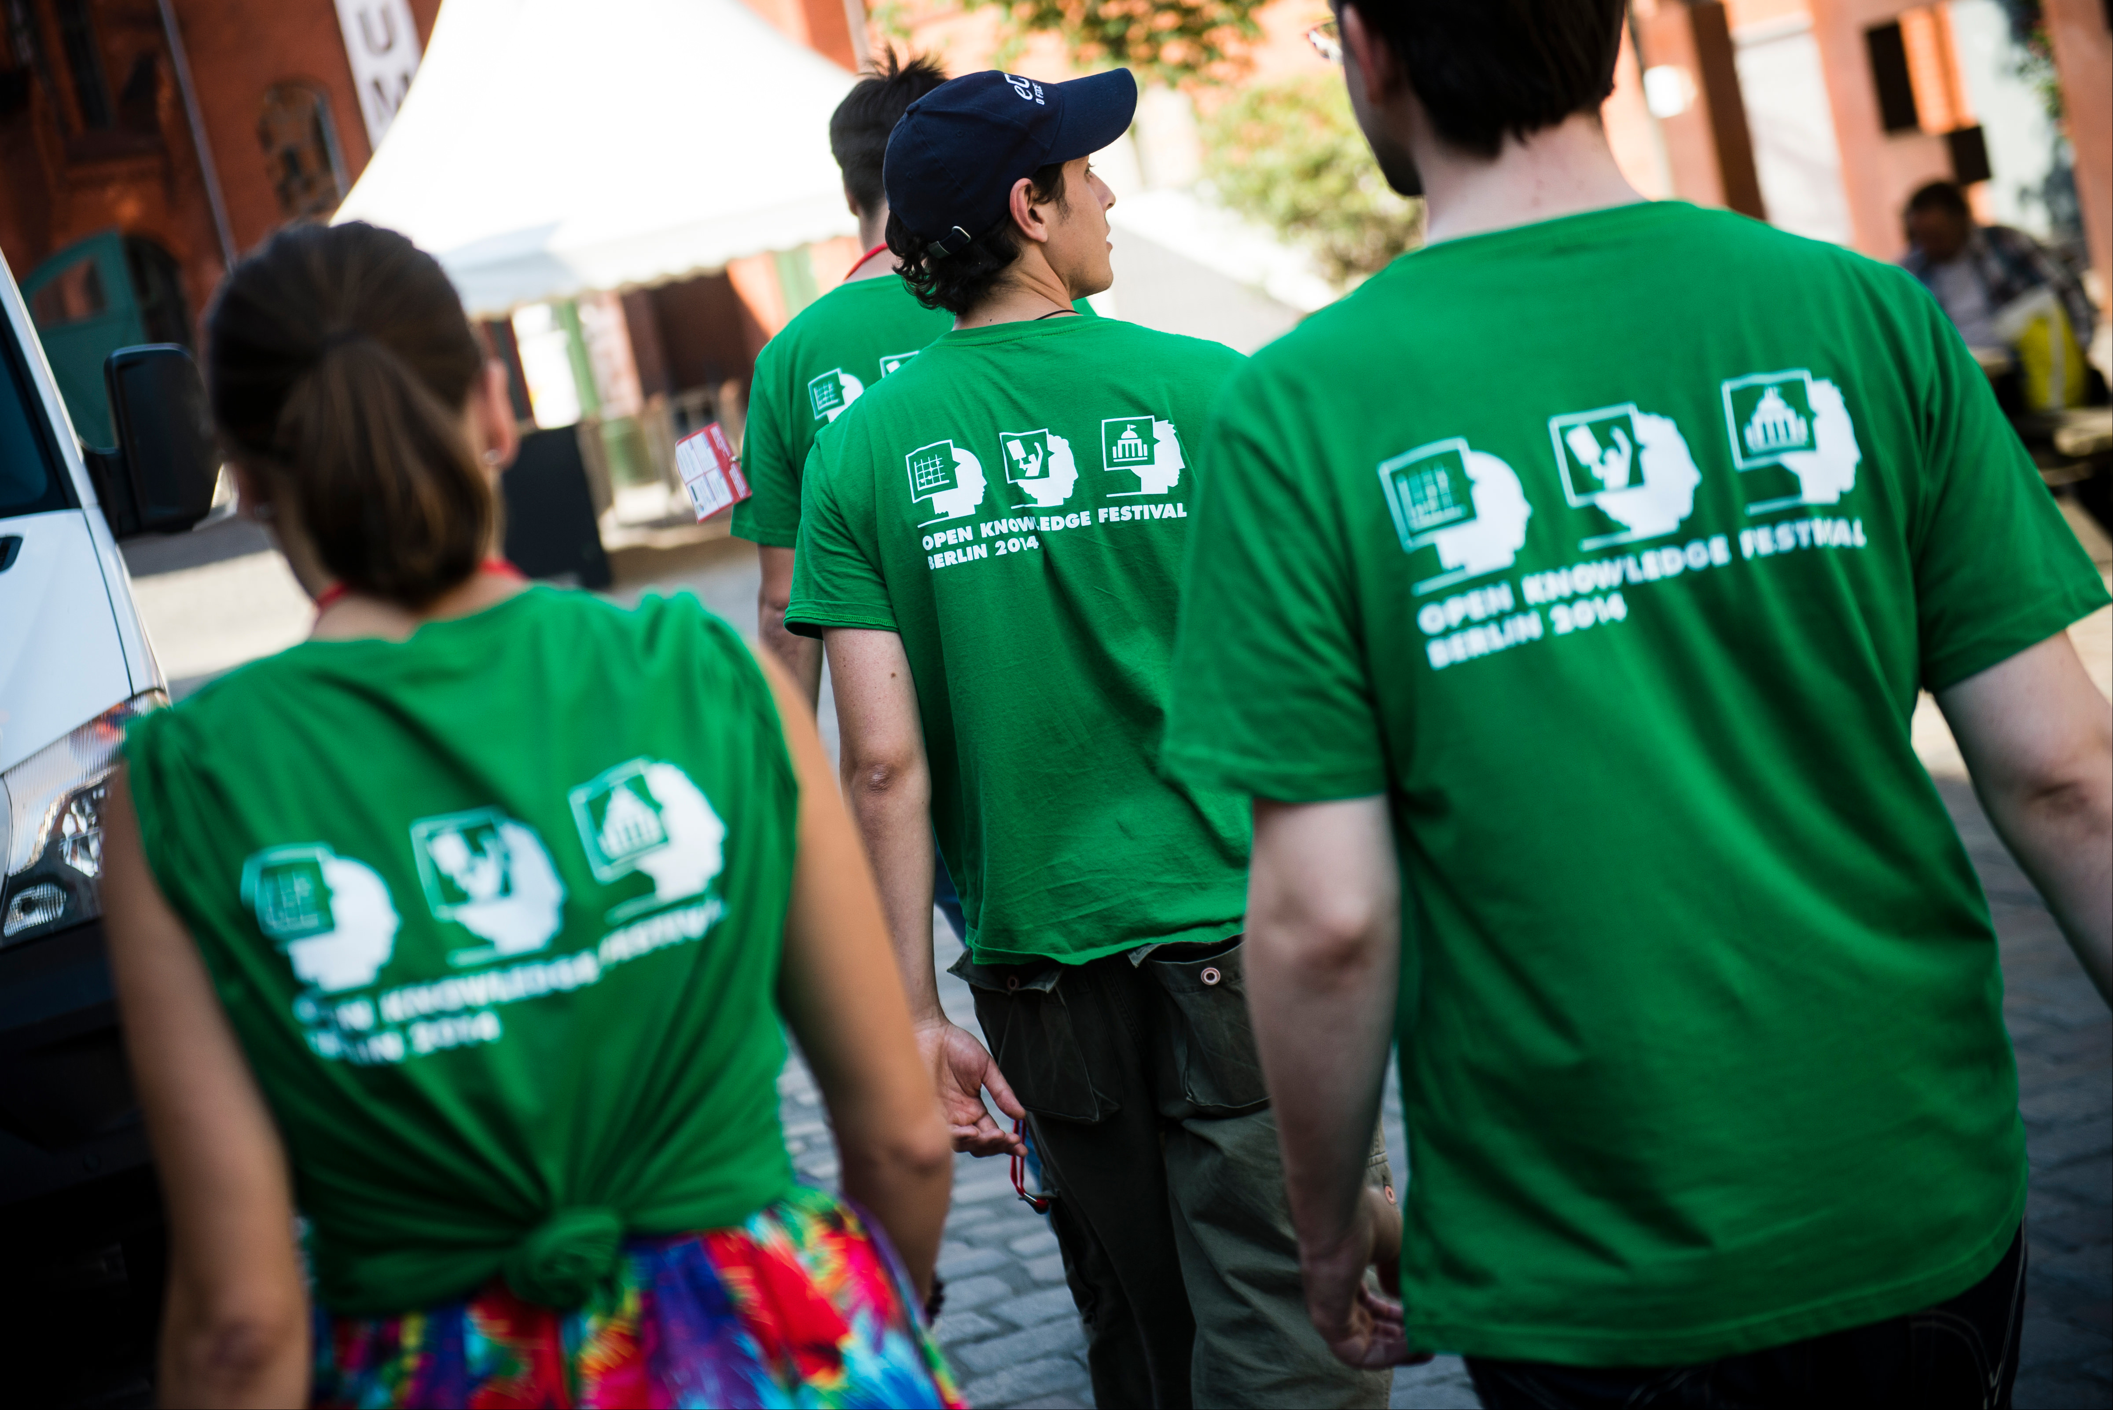
Incident Responder Duties
Take an incident report
Protect reporter privacy
Discuss with committee
Behavioral modification plan?
Consequences?
Follow up with reported person
Respond to impacted person
Document the incident
CC BY Open Knowledge

Slide 6
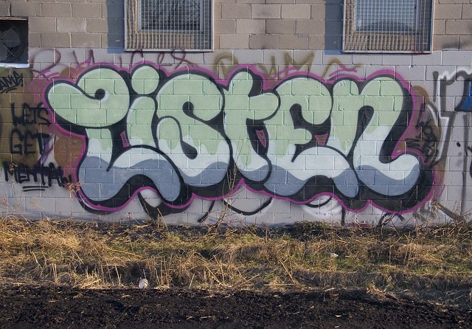
Common Reporter Needs
+ To be heard
+ To be respected
+ To feel safe
~ To create meaning
- To be "right"
- Justice or vengeance
CC BY painteverything

Slide 7
Acknowledging Reporter Emotions
"You felt (emotion) when (behavior)."
Example: "You felt scared when they raised their voice."
Softening the directness:
"So you felt..."
"It sounds like you felt..."
"I'm hearing that you felt..."
"Nonviolent communication" by Marshall B. Rosenberg, PhD

Slide 8
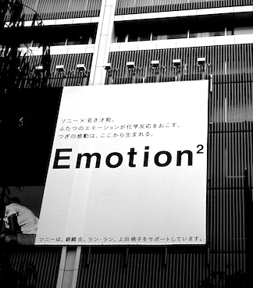
Common Reporter Emotions
Repeating themselves
Becoming flustered
Talking fast
Judgment words
Anger
Mistrust
Emotion CC BY 2.0 Osamu Kaneko

Slide 9

Handling Privacy Concerns
Report will be confidential
Take an anonymous report
Tell reported person a witness overheard / saw
Take an escrow report
Document report
Act after second report
Delay response to protect privacy of 2nd person
Don't mention multiple reports
Locked CC BY 2.0 montillon.a

Slide 10
Report Template
Most important:
Reported person's name and description
Reporter's contact info
Key points of the incident
Tips section
Optional information
Don't ask how you should handle the situation
Link to download report template

Slide 11
Taking an Incident Report: QUEST
Quiet place - offer a private room / private chat
Unsafe - call another incident responder
Emotions - "You felt (emotion) when (behavior)"
Security - how to protect reporter privacy & safety?
Trust - help the reporter feel more welcome
Thank the reporter. Get their contact info.

Slide 12
Instructor modeling
taking a report

Slide 13
Practice
Receiving Reports

Slide 14
Discussion
For the incident responder:
What was hard, complex, or complicated?
For the reporter:
What did the incident responder do well?
What techniques did they use?
Any effective phrases?

Slide 15
Bias in Receiving Incident Reports
Record the behavior & impact
Don't use "judgment" words
Watch yourself for defensiveness
Be cautious about empathy for reported person

Slide 16



Intent vs. Impact
Intent
behavior

Slide 17

Intent is Not Magic
Action or inaction has impact
Good intent still causes harm
Goal: Stop the behavior
Do they understand why their behavior was inappropriate?
Do they agree to change?
Afterwards: Based on your conversation, does the reporter intend to continue the behavior?
CC BY Fabricio Zuardi
(modified)

Slide 18

Microaggressions: Constant Inequality
Harm caused because your identity is not considered "the default"
e.g. disability, race, gender
May happen daily
Invisible to the "default" identity
Death by 1,000 paper cuts
CC BY Andrew McGill

Slide 19
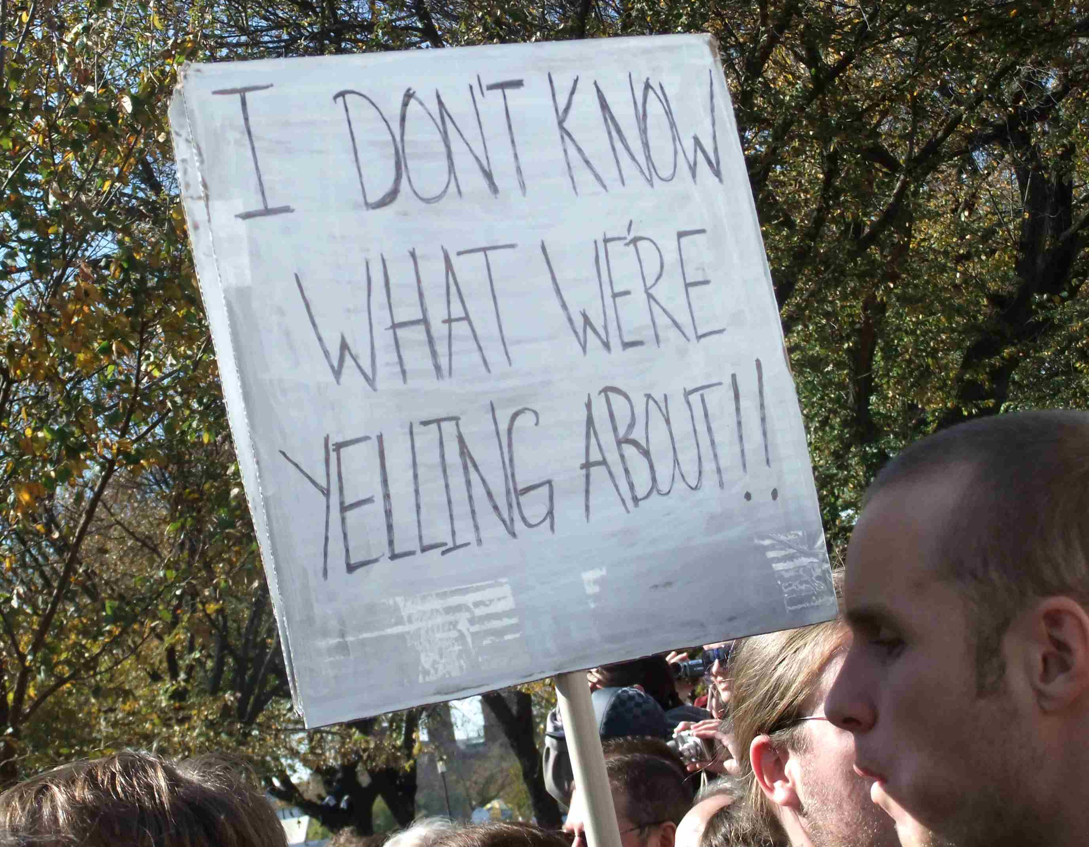
Personal Conflicts
Not all conflicts will be a Code of Conduct violation
Communication breakdown
Is this a pattern?
Know emotional and verbal abuse behaviors: http://outofthefog.website/traits/
CC BY Martha Soukup

Slide 20
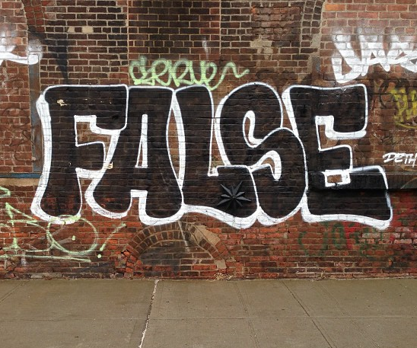
What about False Reporting?
What does a reporter have to lose?
Community
Career
Safety & mental health
Society favors reported person
less likely to face consequences
Microaggressions & sexual harassment are under reported
Believe reporters by default
CC BY Adam Lehman

Slide 21

Reversed Power Dynamics
Be cautious of when the power dynamic is reversed:
"racism against white people"
"sexist discrimination of men"
other "reverse-isms"
Reporting process can be used to harass minorities
"Our CoC Committee determined this was not a Code of Conduct violation"
CC BY Jesper Sehested
Pluslexia.com

Slide 22
(Break)
Following up on
Incident Reports

Slide 23
Evaluating Reports Risk vs. Impact
Risk:
physically unsafe?
impacts mental health?
risk of behavior being repeated?
Impact:
number of witnesses
authority / leadership of reported person
impact to people from marginalized groups

Slide 24
Evaluating Risk: Examples
 | Low Risk | High Risk
Low Impact | Inappropriate comment in private conversation | Repeated inappropriate comments after warning
High Impact | Racist "joke" during a presentation or in public channel | Stalking Sexual assault

Slide 25
Potential Consequences
Warning
Final Warning
Removal from leadership positions
Do not interact with reporter
Temporary Ban
Permanent Ban

Slide 26
Evaluating Risk: Examples
 | Low Risk | High Risk
Low Impact | Inappropriate comment in private conversation | Repeated inappropriate comments after warning
High Impact | Racist "joke" during a presentation or in public channel | Stalking Sexual assault

Slide 27
Deciding Response: Examples
 | Low Risk | High Risk
Low Impact | Issue warning | Monitor and document patterns of behavior, warn or temporary ban, remove from leadership
High Impact | Reprimand, removal of offensive material Public response from staff or organization | Permanent Ban

Slide 28
Before Speaking to a Reported Person
Write down:
Their behavior and impact
A behavioral modification plan
Consequences for their behavior (?)
What will happen if they don't agree to modify their behavior?
Who can they appeal the decision to?

Slide 29
Common Emotions for People who have been reported
Emotion | Action
Anger | Defensiveness
Fear | Denial
Humiliation | Blame shifting
Anxiety | Seek reassurance
Disgust | Self blame
Abandonment | Manipulation

Slide 30
Successfully Encouraging Change in Reported People
Goal is to change inappropriate behavior
You will see defensiveness
Reiterate behavior and impact
Focus on shared community goals:
safe, inclusive, welcoming, collaboration, creativity, constructive communication
Offer private ways to practice new skills

Slide 31
Following up with the reported person: BIRDS
Go to a private place / private message or video chat
Have an exit plan. Bring another responder if a ban is likely.
State what their Behavior was without judgment words
State the Impact on the reporter or community
Allow the reported person to Respond
Don't reassure or allow the reporter to be contacted
Set a behavioral modification plan
Offer to relay any apologies
Notes:
“Hi, can I speak with you privately?”
“That's not appropriate.”
“They asked you to stop.”
“This is a private venue.”

Slide 32
Practice:
Following up with
the Reported Person

Slide 33
Discussion
For the incident responder:
What was hard, complex, or complicated?
For the reported person:
What did the incident responder do well?
What techniques did they use?
Any effective phrases?

Slide 34
Following up after an incident
Try to talk to everyone impacted
May need a public statement
Transparency reports
Whisper networks exist
Document the incident
May need to notify volunteers

Slide 35
Q&A

Slide 36
Advanced Topics

Slide 37
Systemic Inequality
Collective lack of action
Biased harmful policies or systems
Negatively impacts marginalized groups
Example: No 'religious symbols' policies
Must choose between a headscarf & education/jobs
2x more Muslim girls don't go to secondary school in France
Source: https://www.washingtonpost.com/politics/2019/06/03/how-will-austrias-new-headscarf-ban-affect-muslims/?noredirect=on

Slide 38
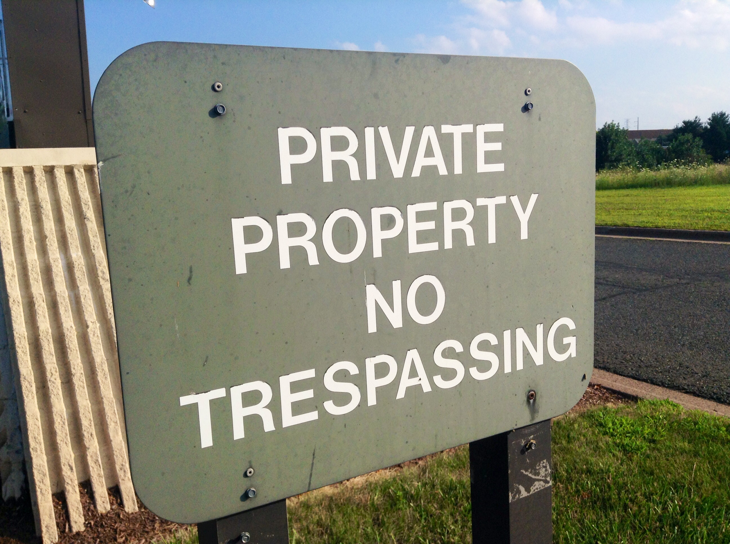
Dealing with Unwelcome Attendees
“You aren’t permitted to attend the conference”
Don’t provide details
Ask them to leave
“This is a private venue”
Get onsite help
Report for trespassing
Know your local trespassing laws
CC BY Mike Mozart

Slide 39
Dealing with Weapons Policy Violations
“Weapons are not allowed at our conference”
Ask them to leave
Come back without the weapon
Do not argue, be firm
Ask staff, response team, security to help
If there is a safety risk, call 911

Slide 40
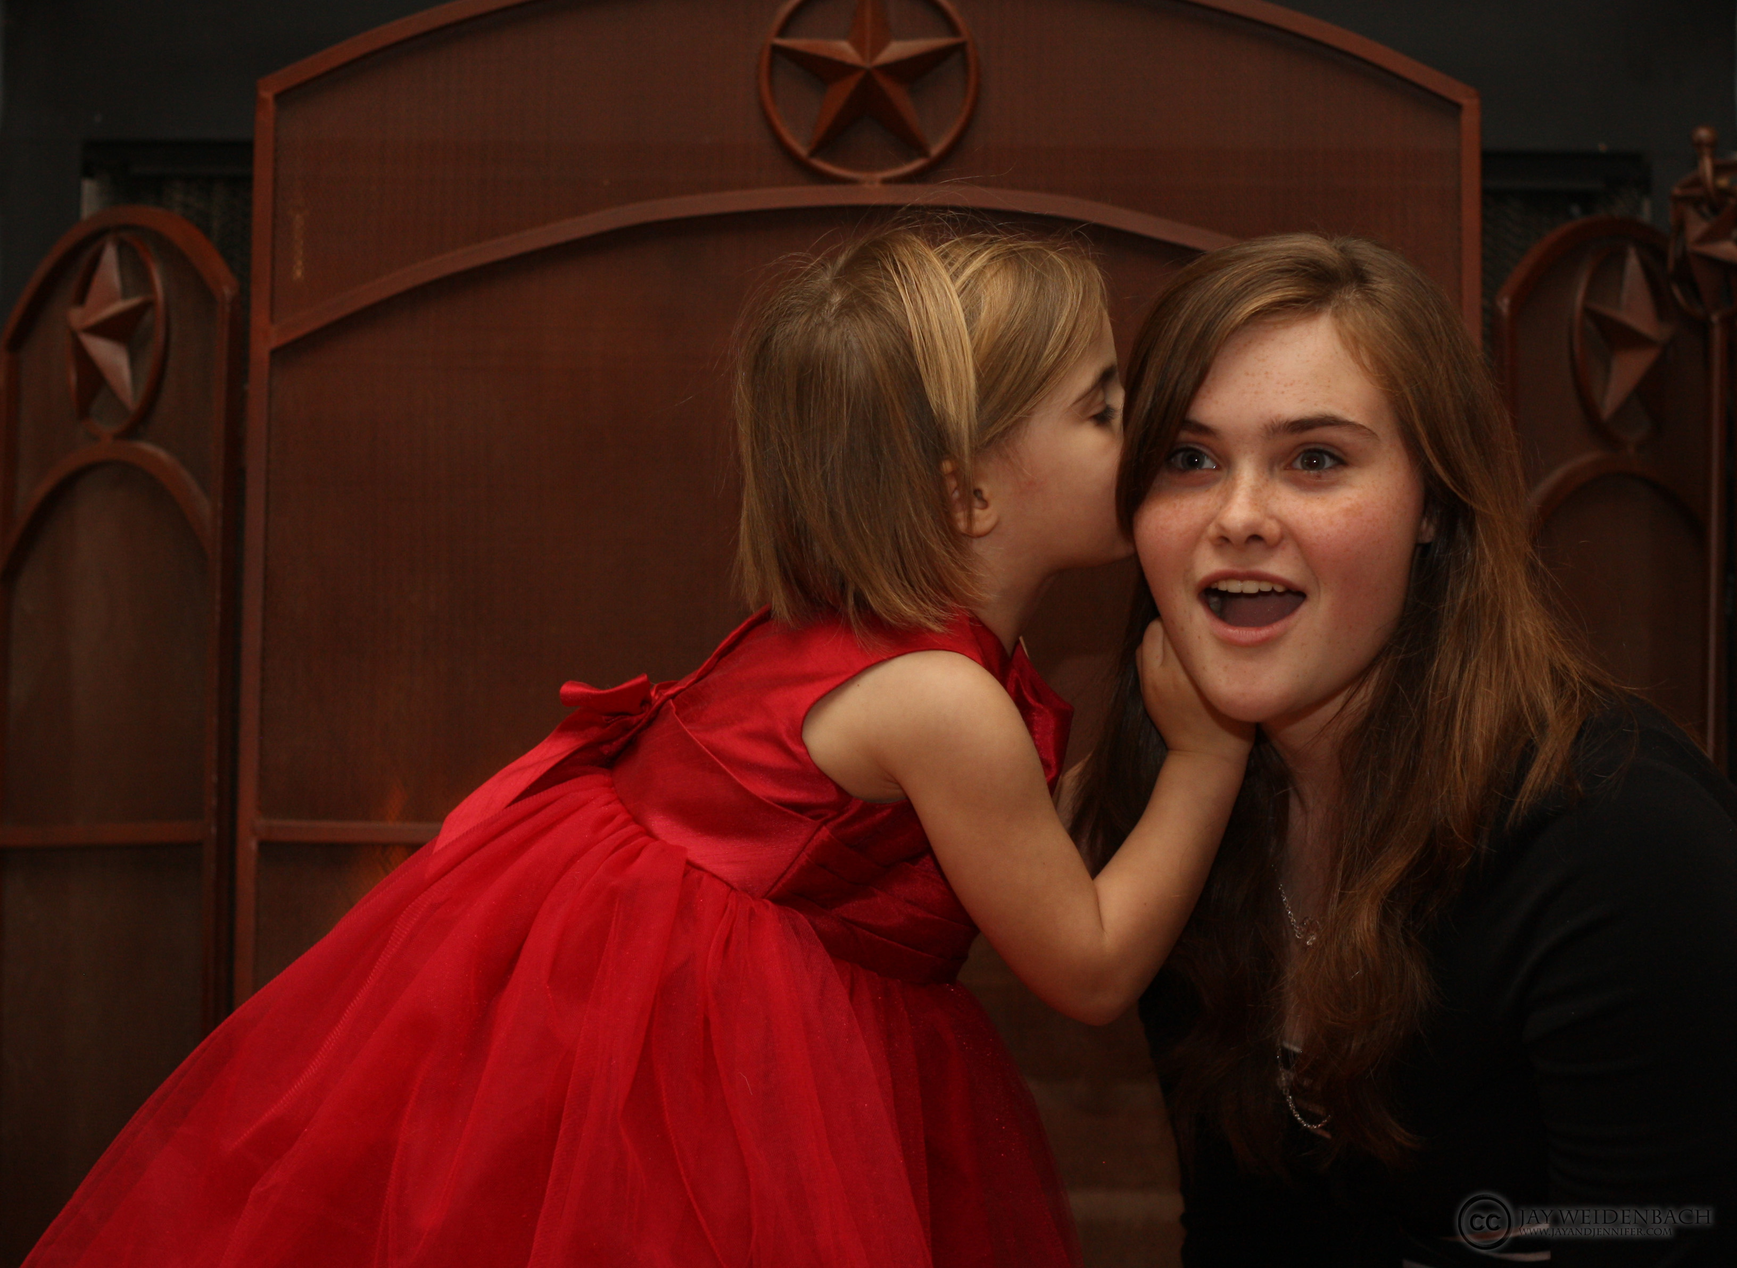
Conflicts of Interest
Is anyone a friend or coworker?
conference staff or volunteers
incident response team
papers committee
sponsors
Review leadership positions for potential leaks:
other incident responders
volunteers & staff
papers committee
board members
CC BY Jay Weldenbach

Slide 41
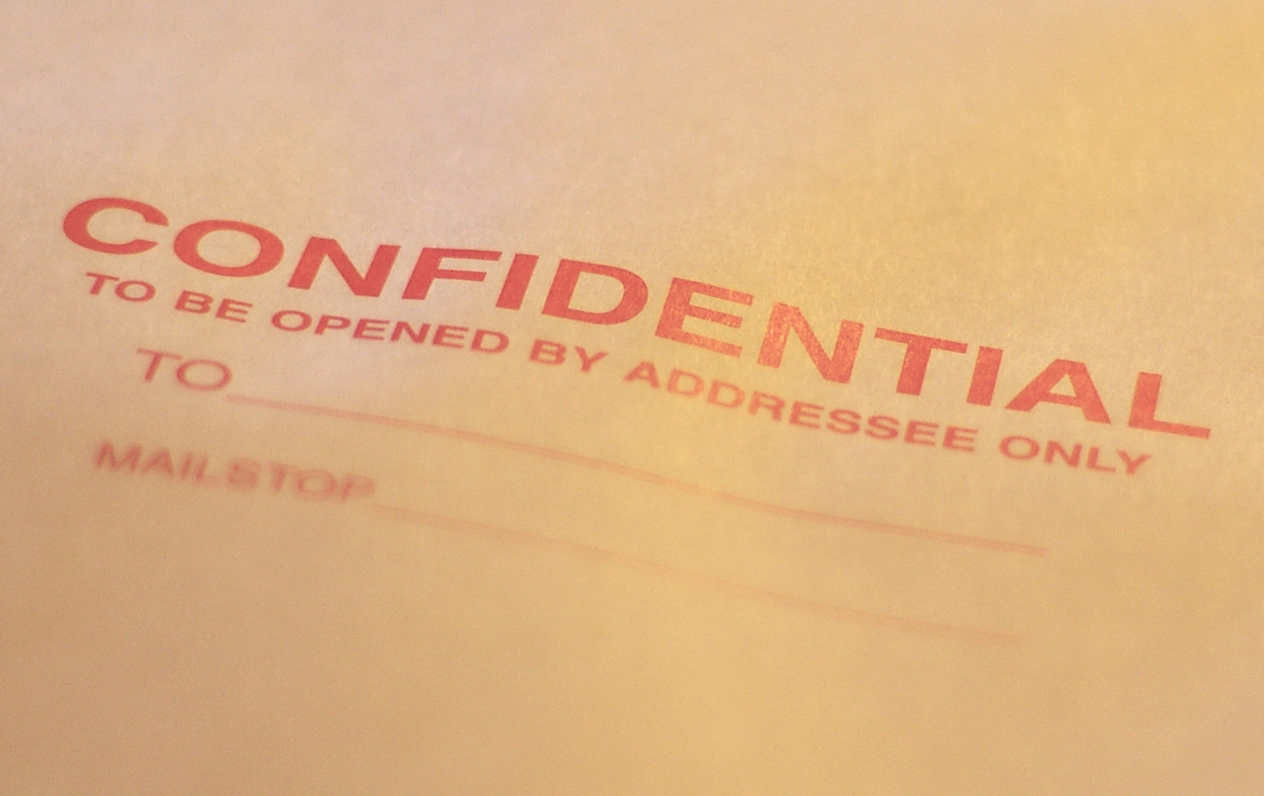
Confidentiality Issues
Reporter fears retaliation
NDAs & severance
Police Investigation
Limit incident docs access
Ask around (discretely)
Often multiple incidents
Other grounds to dismiss
CC BY Casey Marshall

Slide 42
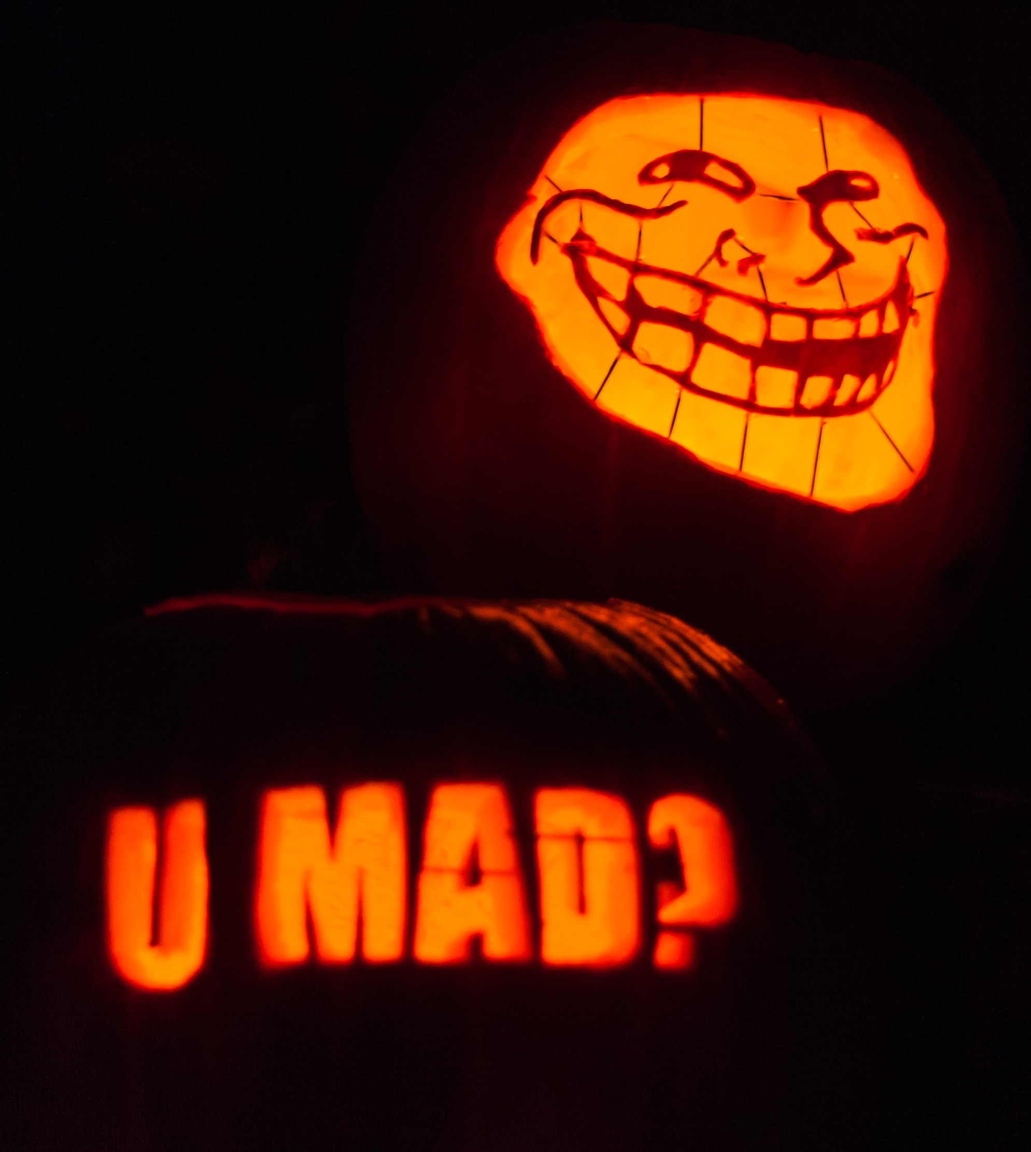
Known Harassers
Not just internet trolls
Stalkers do show up
Power plays & disruption
Have a mitigation plan
Strict confidentiality plan
Ensure attendee safety
CC BY Paul VanDerWerf

